Slide 1
Data Mining
Association Analysis:
Basic Concepts and Algorithms
© Tan,Steinbach, Kumar Introduction to Data Mining 4/18/2004 <number>

Slide 2

Association Rule Mining
Given a set of transactions, find rules that will predict the occurrence of an item based on the occurrences of other items in the transaction
Market-Basket transactions
Example of Association Rules
{Diaper} → {Beer},
{Milk, Bread} → {Eggs,Coke},
{Beer, Bread} → {Milk},
Implication means co-occurrence, not causality!

Slide 3

Definition: Frequent Itemset
Itemset
  A collection of one or more items
    Example: {Milk, Bread, Diaper}
  k-itemset
    An itemset that contains k items
Support count (σ)
  Frequency of occurrence of an itemset
  E.g. σ({Milk, Bread,Diaper}) = 2
Support
  Fraction of transactions that contain an itemset
  E.g. s({Milk, Bread, Diaper}) = 2/5
Frequent Itemset
  An itemset whose support is greater than or equal to a minsup threshold

Slide 4



Definition: Association Rule
Association Rule
  An implication expression of the form X → Y, where X and Y are itemsets
  Example:
  {Milk, Diaper} → {Beer}
Rule Evaluation Metrics
  Support (s)
    Fraction of transactions that contain both X and Y
  Confidence (c)
    Measures how often items in Y
    appear in transactions that
    contain X
Example:

Slide 5
Association Rule Mining Task
Given a set of transactions T, the goal of association rule mining is to find all rules having
  support ≥ minsup threshold
  confidence ≥ minconf threshold
Brute-force approach:
  List all possible association rules
  Compute the support and confidence for each rule
  Prune rules that fail the minsup and minconf thresholds
  ⇒ Computationally prohibitive!

Slide 6
Mining Association Rules
Example of Rules:
{Milk,Diaper} → {Beer} (s=0.4, c=0.67)
{Milk,Beer} → {Diaper} (s=0.4, c=1.0)
{Diaper,Beer} → {Milk} (s=0.4, c=0.67)
{Beer} → {Milk,Diaper} (s=0.4, c=0.67)
{Diaper} → {Milk,Beer} (s=0.4, c=0.5)
{Milk} → {Diaper,Beer} (s=0.4, c=0.5)
Observations:
All the above rules are binary partitions of the same itemset:
{Milk, Diaper, Beer}
Rules originating from the same itemset have identical support but
can have different confidence
Thus, we may decouple the support and confidence requirements

Slide 7
Mining Association Rules
Two-step approach:
  Frequent Itemset Generation
    Generate all itemsets whose support ≥ minsup
  Rule Generation
    Generate high confidence rules from each frequent itemset, where each rule is a binary partitioning of a frequent itemset
Frequent itemset generation is still computationally expensive

Slide 8

Frequent Itemset Generation
Given d items, there are 2^{d} possible candidate itemsets

Slide 9

Frequent Itemset Generation
Brute-force approach:
  Each itemset in the lattice is a candidate frequent itemset
  Count the support of each candidate by scanning the database
  Match each transaction against every candidate
  Complexity ~ O(NMw) => Expensive since M = 2^{d} !!!

Slide 10
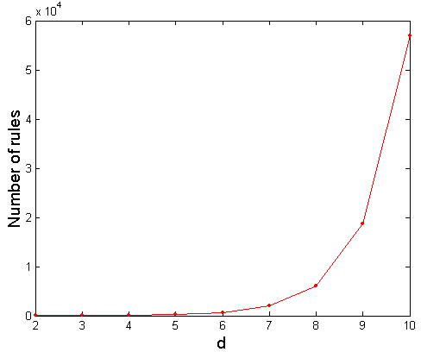
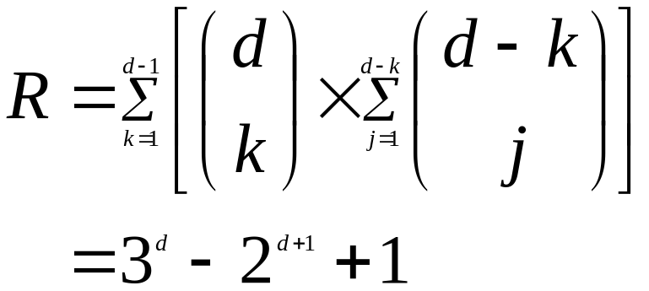
Computational Complexity
Given d unique items:
  Total number of itemsets = 2^{d}
  Total number of possible association rules:
If d=6, R = 602 rules

Slide 11
Frequent Itemset Generation Strategies
Reduce the number of candidates (M)
  Complete search: M=2^{d}
  Use pruning techniques to reduce M
Reduce the number of transactions (N)
  Reduce size of N as the size of itemset increases
Reduce the number of comparisons (NM)
  Use efficient data structures to store the candidates or transactions
  No need to match every candidate against every transaction

Slide 12
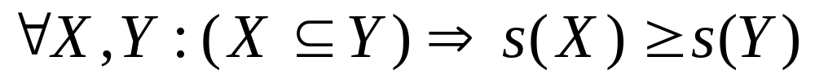
Reducing Number of Candidates
Apriori principle:
  If an itemset is frequent, then all of its subsets must also be frequent
Apriori principle holds due to the following property of the support measure:
  Support of an itemset never exceeds the support of its subsets
  This is known as the anti-monotone property of support

Slide 13


Illustrating Apriori Principle
Found to be Infrequent
Pruned supersets

Slide 14

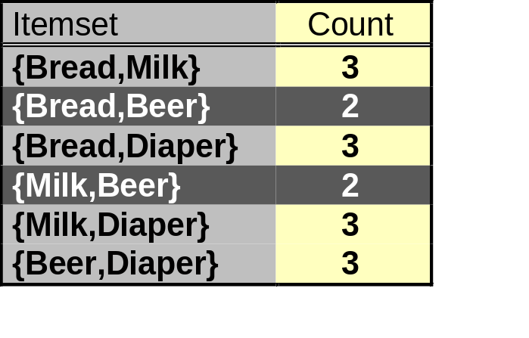
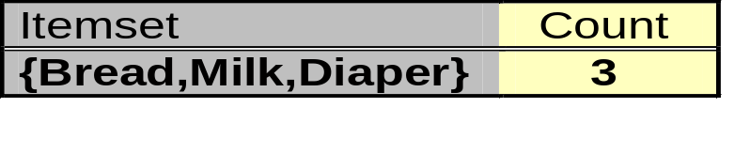
Illustrating Apriori Principle
Items (1-itemsets)
Pairs (2-itemsets)
(No need to generate
candidates involving Coke
or Eggs)
Minimum Support = 3
Triplets (3-itemsets)
If every subset is considered,
⁶C₁ + ⁶C₂ + ⁶C₃ = 41
With support-based pruning,
6 + 6 + 1 = 13

Slide 15
Apriori Algorithm
Method:
  Let k=1
  Generate frequent itemsets of length 1
  Repeat until no new frequent itemsets are identified
    Generate length (k+1) candidate itemsets from length k frequent itemsets
    Prune candidate itemsets containing subsets of length k that are infrequent
    Count the support of each candidate by scanning the DB
    Eliminate candidates that are infrequent, leaving only those that are frequent
How?

Slide 16
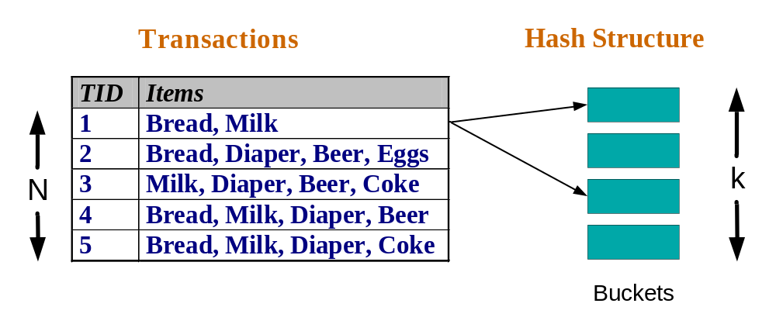
Reducing Number of Comparisons
Candidate counting:
  Scan the database of transactions to determine the support of each candidate itemset
  To reduce the number of comparisons, store the candidates in a hash structure
    Instead of matching each transaction against every candidate, match it against candidates contained in the hashed buckets
Could we build a
hash structure over
each transaction,
e.g., a Bloom filter,
then probe it for
each candidate?
Answer: likely
wasteful as each
transaction is not
that big.

Slide 17
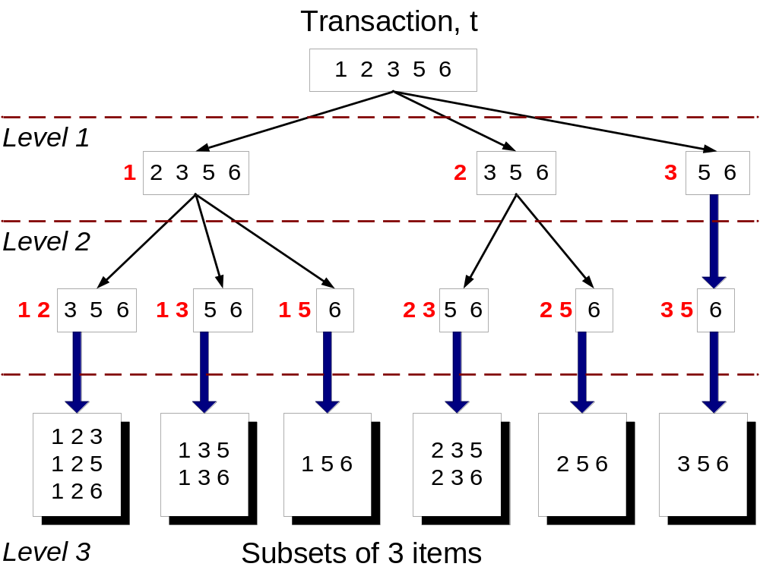
Subset Operation
Given a transaction t, what are the possible subsets of size 3?
First pick any fixed order of items.
This is just generating combinations! A systematic way.

Slide 18
Generate Hash Tree
Suppose you have 15 candidate itemsets of length 3:
{1 4 5}, {1 2 4}, {4 5 7}, {1 2 5}, {4 5 8}, {1 5 9}, {1 3 6}, {2 3 4}, {5 6 7}, {3 4 5}, {3 5 6}, {3 5 7}, {6 8 9}, {3 6 7}, {3 6 8}
You need:
Hash function
Max leaf size: max number of itemsets stored in a leaf node (if number of candidate itemsets exceeds max leaf size, split the node)
Hash function
2 3 4
5 6 7
3,6,9
1,4,7
1 4 5
3 4 5
3 5 6
3 5 7
6 8 9
3 6 7
3 6 8
1 3 6
2,5,8
1 2 4
4 5 7
Distribute itemsets by hashing each item in order. What if candidate distribution is skewed? A: Work on your hash function.
1 2 5
4 5 8
1 5 9
Is the height of the tree limited by 3?
A: No… you can pick any piece of it
and hash with any function you like…

Slide 19
Subset Operation Using Hash Tree
1 2 3 5 6
transaction
Hash Function
1 +
2 3 5 6
2 +
3 5 6
1,4,7
3,6,9
3 +
5 6
2,5,8
2 3 4
5 6 7
1 4 5
1 3 6
3 4 5
3 5 6
3 6 7
3 5 7
3 6 8
1 2 4
1 2 5
1 5 9
6 8 9
4 5 7
4 5 8
This combines previous 2 slides: generate 3-combo’s from transaction & probe the tree

Slide 20
Factors Affecting Complexity
Choice of minimum support threshold
  lowering support threshold results in more frequent itemsets
  this may increase number of candidates and max length of frequent itemsets
Dimensionality (number of items) of the data set
  more space is needed to store support count of each item
  if number of frequent items also increases, both computation and I/O costs may also increase
Size of database
  since Apriori makes multiple passes, run time of algorithm may increase with number of transactions
Average transaction width
  transaction width increases with denser data sets
  This may increase max length of frequent itemsets and traversals of hash tree (number of subsets in a transaction increases with its width)

Slide 21
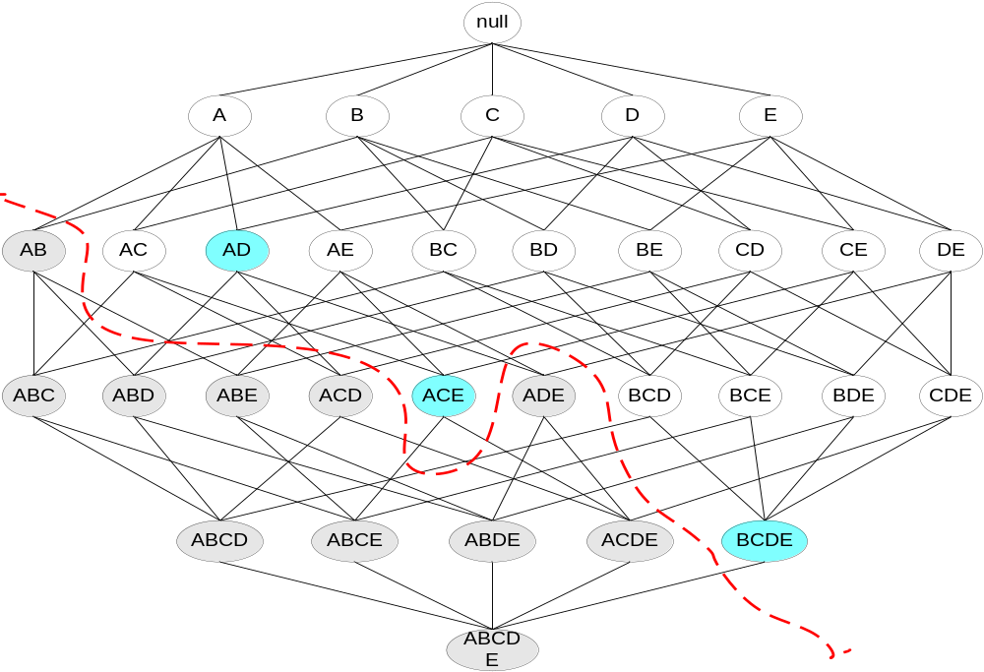
Maximal Frequent Itemset
An itemset is maximal frequent if none of its immediate supersets is frequent
Maximal Itemsets
Infrequent Itemsets
Border

Slide 22
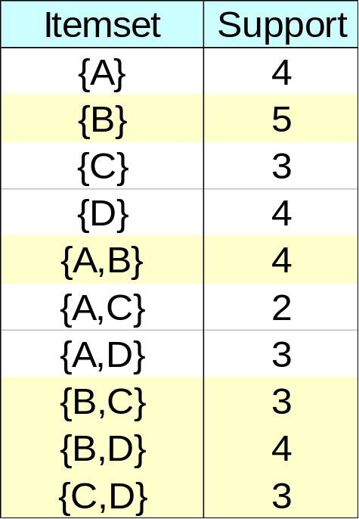
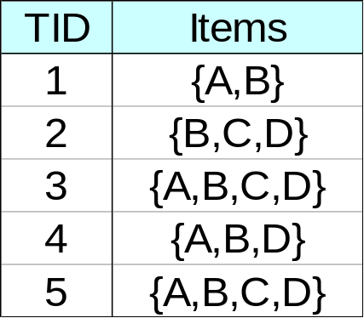
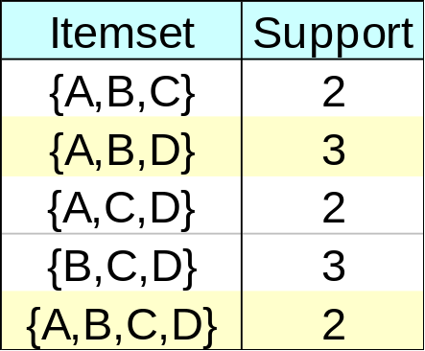
Closed Itemset
An itemset is closed if none of its immediate supersets has the same support as the itemset

Slide 23
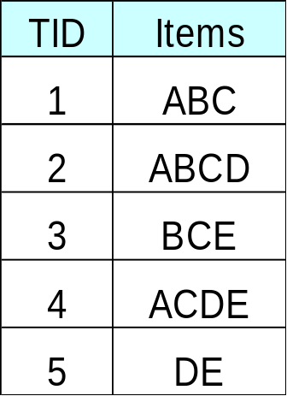
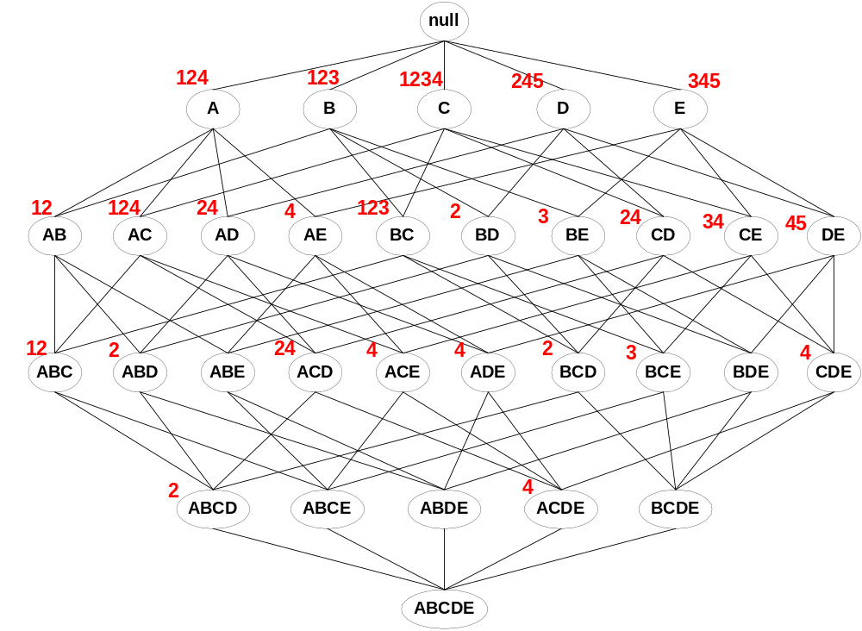
Maximal vs Closed Itemsets
Transaction Ids
Not supported by any transactions

Slide 24
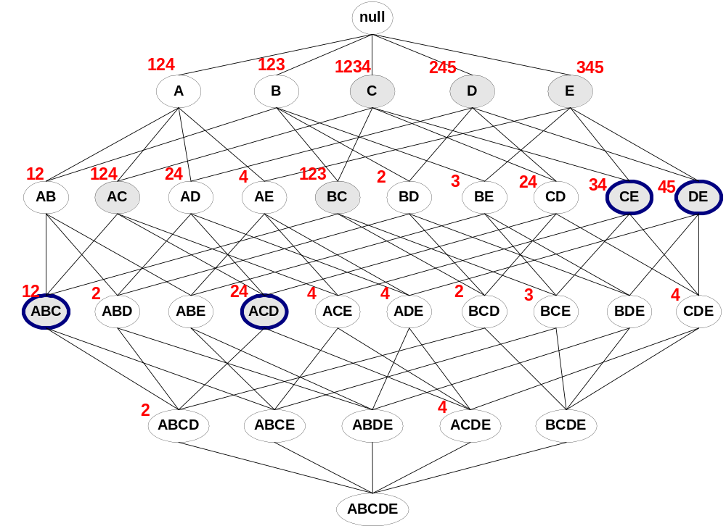
Maximal vs Closed Frequent Itemsets
Minimum support = 2
Closed but not maximal
Closed and maximal
# Closed = 9
# Maximal = 4

Slide 25
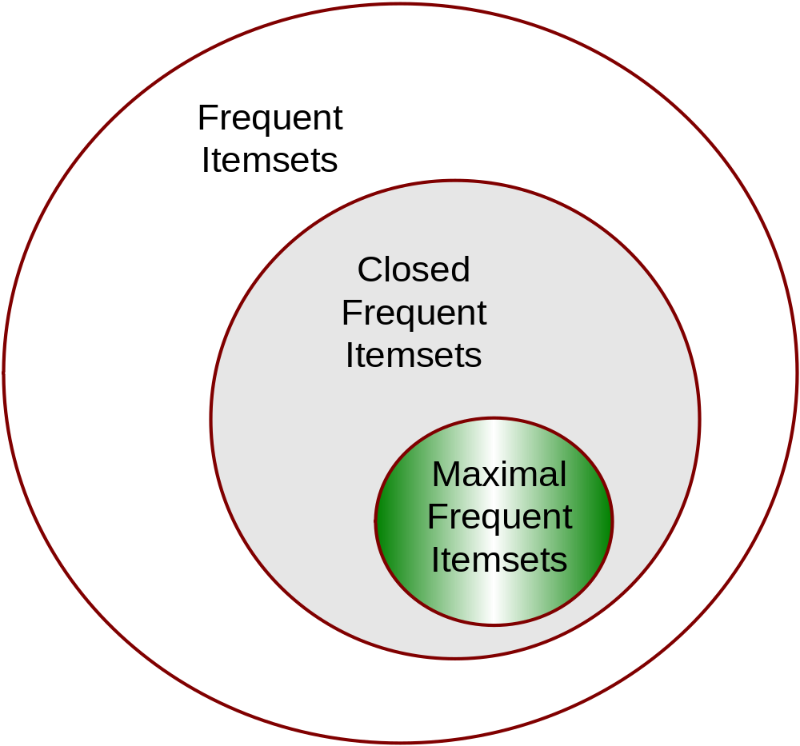
Maximal vs Closed Itemsets

Slide 26
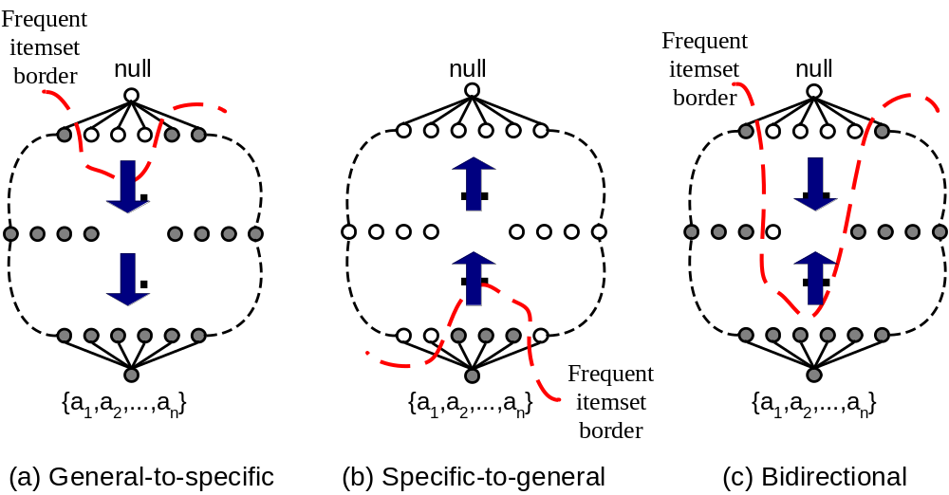
Alternative Methods for Frequent Itemset Generation
Traversal of Itemset Lattice
  General-to-specific vs Specific-to-general

Slide 27
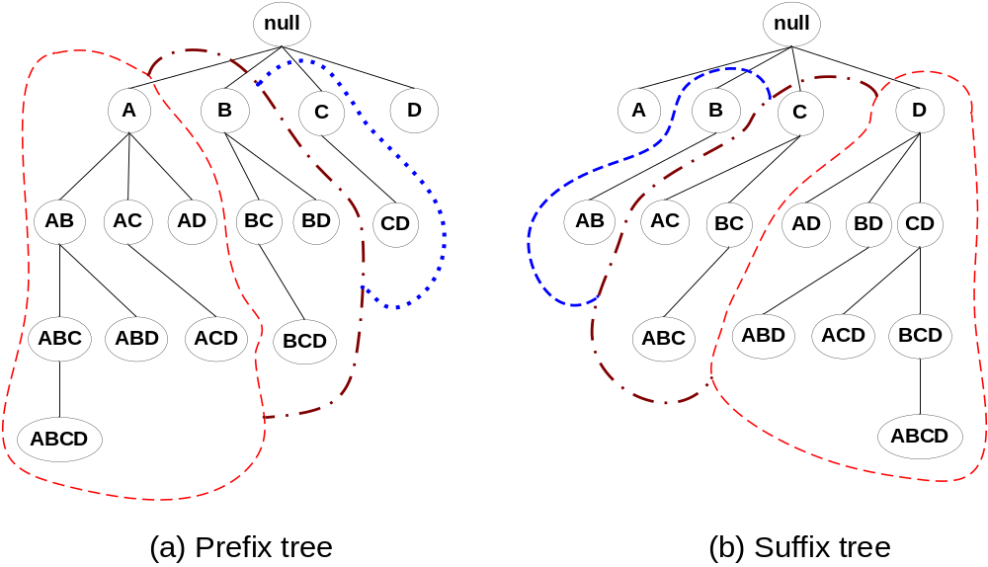
Alternative Methods for Frequent Itemset Generation
Traversal of Itemset Lattice
  Equivalent Classes

Slide 28
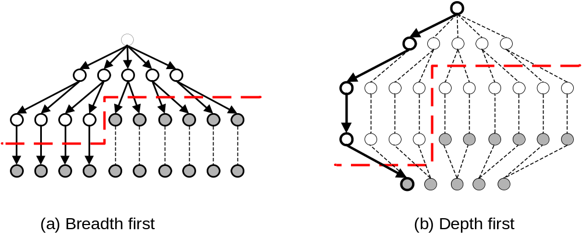
Alternative Methods for Frequent Itemset Generation
Traversal of Itemset Lattice
  Breadth-first vs Depth-first

Slide 29
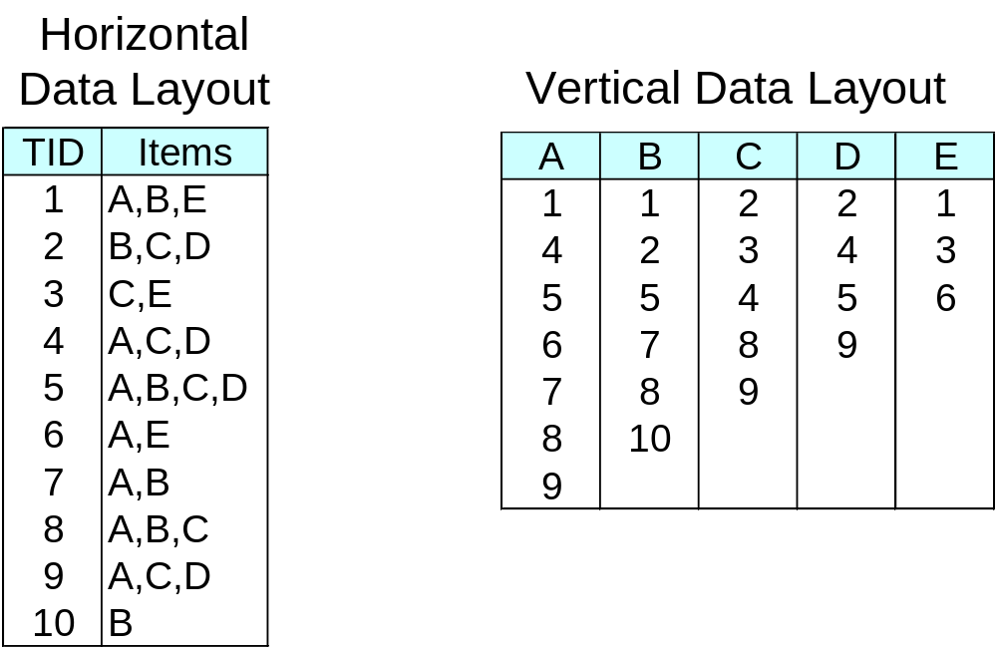
Alternative Methods for Frequent Itemset Generation
Representation of Database
  horizontal vs vertical data layout

Slide 30
FP-growth Algorithm
Use a compressed representation of the database using an FP-tree
Once an FP-tree has been constructed, it uses a recursive divide-and-conquer approach to mine the frequent itemsets

Slide 31
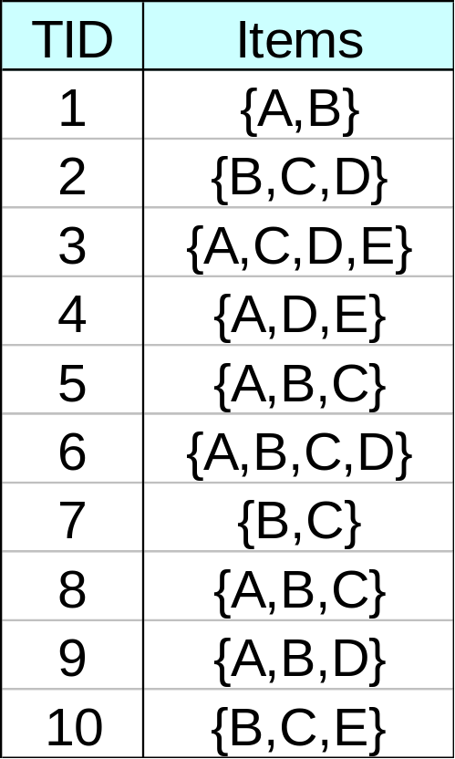
FP-tree Construction
null
After reading TID=1:
A:1
B:1
After reading TID=2:
null
A:1
B:1
B:1
C:1
D:1

Slide 32
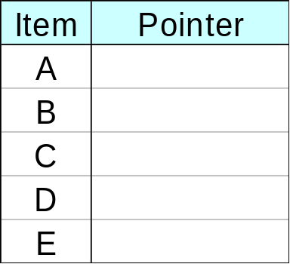
FP-Tree Construction
Transaction Database
null
A:7
B:3
B:5
C:3
C:1
D:1
Header table
D:1
C:3
E:1
D:1
E:1
D:1
E:1
D:1
Pointers are used to assist frequent itemset generation

Slide 33
FP-growth
null
Conditional Pattern base for D:
P = {(A:1,B:1,C:1),
(A:1,B:1),
(A:1,C:1),
(A:1),
(B:1,C:1)}
Recursively apply FP-growth on P
Frequent Itemsets found (with sup > 1):
AD, BD, CD, ACD, BCD
A:7
B:1
B:5
C:1
C:1
D:1
C:3
D:1
D:1
D:1
D:1

Slide 34
Rule Generation
Given a frequent itemset L, find all non-empty subsets f ⊂ L such that f → L – f satisfies the minimum confidence requirement
  If {A,B,C,D} is a frequent itemset, candidate rules:
    ABC →D, ABD →C, ACD →B, BCD →A,
    A →BCD, B →ACD, C →ABD, D →ABC
    AB →CD, AC → BD, AD → BC, BC →AD,
    BD →AC, CD →AB,
If |L| = k, then there are 2^{k} – 2 candidate association rules (ignoring L → ∅ and ∅ → L)

Slide 35
Rule Generation
How to efficiently generate rules from frequent itemsets?
  In general, confidence does not have an anti-monotone property
    c(ABC →D) can be larger or smaller than c(AB →D)
  But confidence of rules generated from the same itemset has an anti-monotone property
  e.g., L = {A,B,C,D}:
  c(ABC → D) ≥ c(AB → CD) ≥ c(A → BCD)
    Confidence is anti-monotone w.r.t. number of items on the RHS of the rule

Slide 36
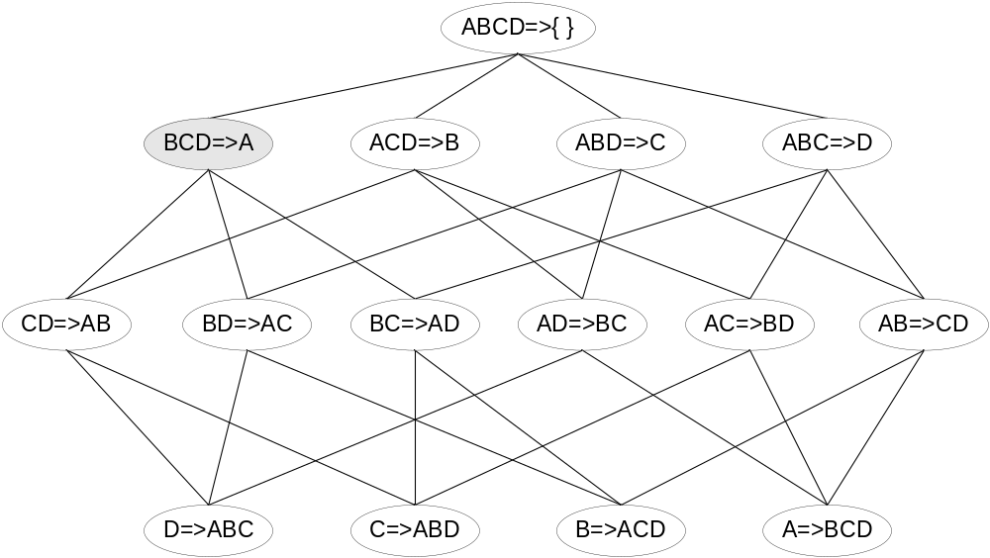

Rule Generation for Apriori Algorithm
Lattice of rules
Low Confidence Rule
Pruned Rules

Slide 37
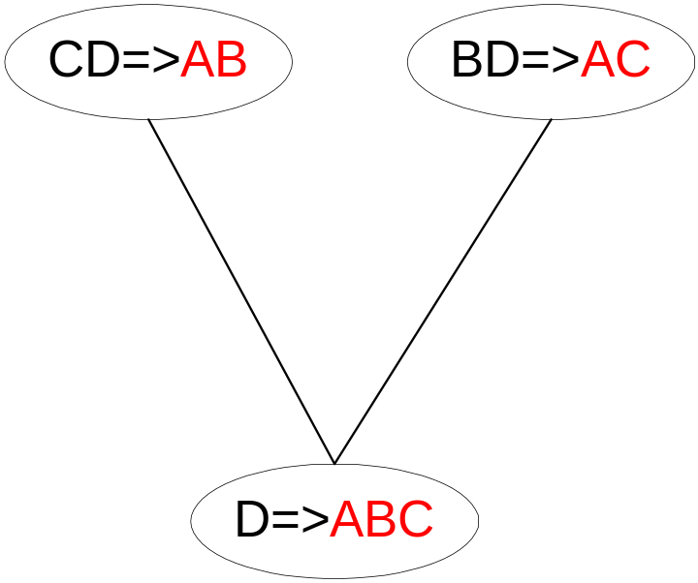
Rule Generation for Apriori Algorithm
Candidate rule is generated by merging two rules that share the same prefix
in the rule consequent
join(CD=>AB,BD=>AC)
would produce the candidate
rule D => ABC
Prune rule D=>ABC if its
subset AD=>BC does not have
high confidence

Slide 38
Apriori Algorithm
Find all itemsets with Sup>=2
Database D
1-candidates
Freq 1-itemsets
2-candidates
TID | Items
10 | a, c, d
20 | b, c, e
30 | a, b, c, e
40 | b, e
Itemset | Sup
a | 2
b | 3
c | 3
d | 1
e | 3
Itemset | Sup
a | 2
b | 3
c | 3
e | 3
Itemset
ab
ac
ae
bc
be
ce
Scan D
3-candidates
Freq 2-itemsets
Counting
Scan D
Itemset
bce
Itemset | Sup
ac | 2
bc | 2
be | 3
ce | 2
Itemset | Sup
ab | 1
ac | 2
ae | 1
bc | 2
be | 3
ce | 2
Scan D
Freq 3-itemsets
Itemset | Sup
bce | 2

Slide 39
Apriori Algorithm (cont.)
Association rules generated from 2-itemsets and 3-itemsets:
rule confidence
a→c 2/2
c→a 2/3
b→c 2/3
c→b 2/3
b→e 3/3
e→b 3/3
c→e 2/3
e→c 2/3
rule confidence
bc→e 2/2
ce→b 2/2
eb→c 2/3
b→ce 2/3
c→eb 2/3
e→bc 2/3

Slide 40
Apriori Algorithm (cont.)
If minimum support is 2, minimum confidence is 90%, we have following association rules:
a→c
b→e
e→b
bc→e
ce→b

Slide 41
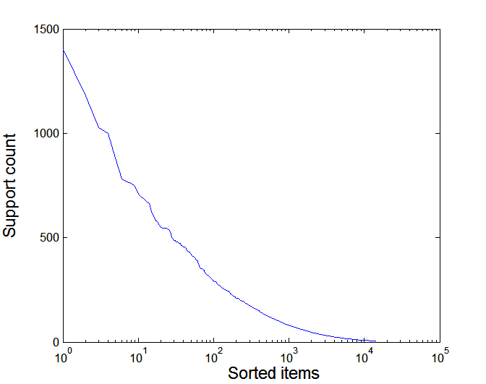
Effect of Support Distribution
Many real data sets have skewed support distribution
Support distribution of a retail data set

Slide 42
Effect of Support Distribution
How to set the appropriate minsup threshold?
  If minsup is set too high, we could miss itemsets involving interesting rare items (e.g., expensive products)
  If minsup is set too low, it is computationally expensive and the number of itemsets is very large
Using a single minimum support threshold may not be effective

Slide 43
Multiple Minimum Support
How to apply multiple minimum supports?
  MS(i): minimum support for item i
  e.g.: MS(Milk)=5%, MS(Coke) = 3%,
  MS(Broccoli)=0.1%, MS(Salmon)=0.5%
  MS({Milk, Broccoli}) = min (MS(Milk), MS(Broccoli))
  = 0.1%
  Challenge: Support is no longer anti-monotone
    Suppose: Support(Milk, Coke) = 1.5% and
    Support(Milk, Coke, Broccoli) = 0.5%
    {Milk,Coke} is infrequent but {Milk,Coke,Broccoli} is frequent
Is “frequent itemset” still anti-monotonic?

Slide 44
Multiple Minimum Support (Liu 1999)
Order the items according to their minimum support (in ascending order)
  e.g.: MS(Milk)=5%, MS(Coke) = 3%,
  MS(Broccoli)=0.1%, MS(Salmon)=0.5%
  Ordering: Broccoli, Salmon, Coke, Milk
Need to modify Apriori such that:
  L₁ : set of frequent items
  F₁ : set of items whose support is ≥ MS(1)
  where MS(1) is min_{i}( MS(i) )
  C₂ : candidate itemsets of size 2 is generated from F₁
  instead of L₁

Slide 45
Multiple Minimum Support (Liu 1999)
Modifications to Apriori:
  In traditional Apriori,
    A candidate (k+1)-itemset is generated by merging two
    frequent itemsets of size k
    The candidate is pruned if it contains any infrequent subsets
    of size k
  Pruning step has to be modified:
    Prune only if subset contains the first item
    e.g.: Candidate={Broccoli, Coke, Milk} (ordered according to
    minimum support)
    {Broccoli, Coke} and {Broccoli, Milk} are frequent but
    {Coke, Milk} is infrequent
      Candidate is not pruned because {Coke,Milk} does not contain
      the first item, i.e., Broccoli.

Slide 46
Pattern Evaluation
Association rule algorithms tend to produce too many rules
  many of them are uninteresting or redundant
  Redundant if {A,B,C} → {D} and {A,B} → {D}
  have same support & confidence
Interestingness measures can be used to prune/rank the derived patterns
In the original formulation of association rules, support & confidence are the only measures used

Slide 47
Computing Interestingness Measure
Given a rule X → Y, information needed to compute rule interestingness can be obtained from a contingency table
Contingency table for X → Y
 | Y | Y
X | f₁₁ | f₁₀ | f₁₊
X | f₀₁ | f₀₀ | f_{o+}
 | f₊₁ | f₊₀ | |T|
f₁₁: support of X and Y
f₁₀: support of X and Y
f₀₁: support of X and Y
f₀₀: support of X and Y
Used to define various measures
support, confidence, lift, Gini,
J-measure, etc.

Slide 48
Drawback of Confidence
 | Coffee | Coffee
Tea | 15 | 5 | 20
Tea | 75 | 5 | 80
 | 90 | 10 | 100
Association Rule: Tea → Coffee
Confidence= P(Coffee|Tea) = 0.75
but P(Coffee) = 0.9
Although confidence is high, rule is misleading
P(Coffee|Tea) = 0.9375

Slide 49
Statistical Independence
Population of 1000 students
  600 students know how to swim (S)
  700 students know how to bike (B)
  420 students know how to swim and bike (S,B)
  P(S∧B) = 420/1000 = 0.42
  P(S) × P(B) = 0.6 × 0.7 = 0.42
  P(S∧B) = P(S) × P(B) => Statistical independence
  P(S∧B) > P(S) × P(B) => Positively correlated
  P(S∧B) < P(S) × P(B) => Negatively correlated

Slide 50
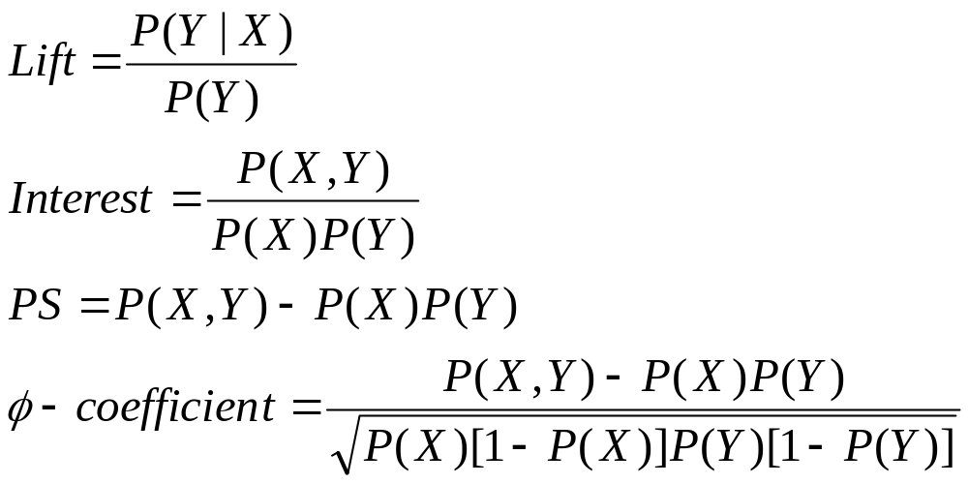
Statistical-based Measures
Measures that take into account statistical dependence

Slide 51
Example: Lift/Interest
 | Coffee | Coffee
Tea | 15 | 5 | 20
Tea | 75 | 5 | 80
 | 90 | 10 | 100
Association Rule: Tea → Coffee
Confidence= P(Coffee|Tea) = 0.75
but P(Coffee) = 0.9
Lift = 0.75/0.9= 0.8333 (< 1, therefore is negatively associated)

Slide 52
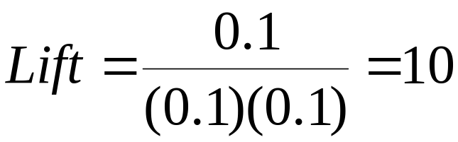
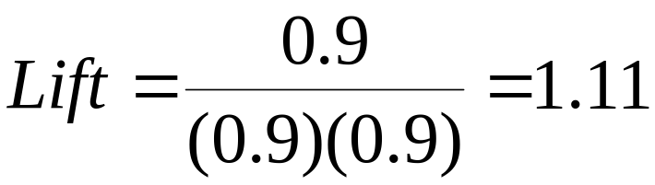
Drawback of Lift & Interest
 | Y | Y
X | 10 | 0 | 10
X | 0 | 90 | 90
 | 10 | 90 | 100
 | Y | Y
X | 90 | 0 | 90
X | 0 | 10 | 10
 | 90 | 10 | 100
Statistical independence:
If P(X,Y)=P(X)P(Y) => Lift = 1

Slide 53
Properties of A Good Measure
Piatetsky-Shapiro:
3 properties a good measure M must satisfy:
  M(A,B) = 0 if A and B are statistically independent
  M(A,B) increase monotonically with P(A,B) when P(A) and P(B) remain unchanged
  M(A,B) decreases monotonically with P(A) [or P(B)] when P(A,B) and P(B) [or P(A)] remain unchanged

Slide 54
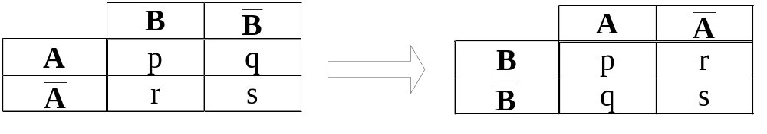
Property under Variable Permutation
Does M(A,B) = M(B,A)?
Symmetric measures:
  support, lift, collective strength, cosine, Jaccard, etc
Asymmetric measures:
  confidence, conviction, Laplace, J-measure, etc

Slide 55
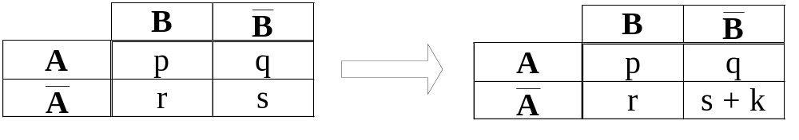
Property under Null Addition
Invariant measures:
  support, cosine, Jaccard, etc
Non-invariant measures:
  correlation, Gini, mutual information, odds ratio, etc

Slide 56
Subjective Interestingness Measure
Objective measure:
  Rank patterns based on statistics computed from data
  e.g., 21 measures of association (support, confidence, Laplace, Gini, mutual information, Jaccard, etc).
Subjective measure:
  Rank patterns according to user’s interpretation
    A pattern is subjectively interesting if it contradicts the
    expectation of a user (Silberschatz & Tuzhilin)
    A pattern is subjectively interesting if it is actionable
    (Silberschatz & Tuzhilin)

Slide 57
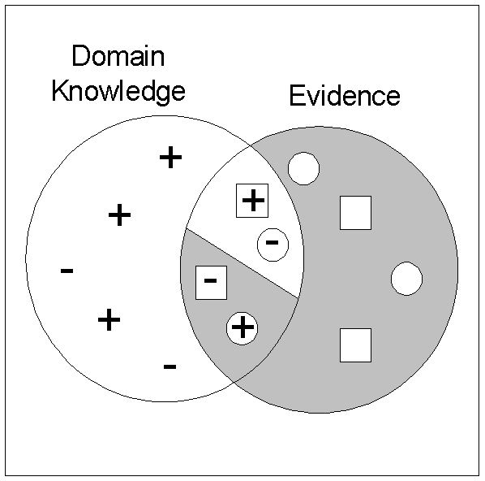
Interestingness via Unexpectedness
Need to model expectation of users (domain knowledge)
Need to combine expectation of users with evidence from data (i.e., extracted patterns)
+
Pattern expected to be frequent
-
Pattern expected to be infrequent
Pattern found to be frequent
Pattern found to be infrequent
+
-
Expected Patterns
-
+
Unexpected Patterns

